Slide 1


﻿Goal-Directed graph generation for anomaly and change detection
September 2019
Università della Svizzera italiana
Amirehsan Davoodi
Supervisors: Cesare Alippi - Daniele Zambon

Slide 2
Contents
Objective
Justification
Introduction
Background /Review of literature
Solution
Implementation
Practical challenges
Validation
Related work
Time frame and work schedule
Future work and conclusion

Slide 3

Objective

Slide 4
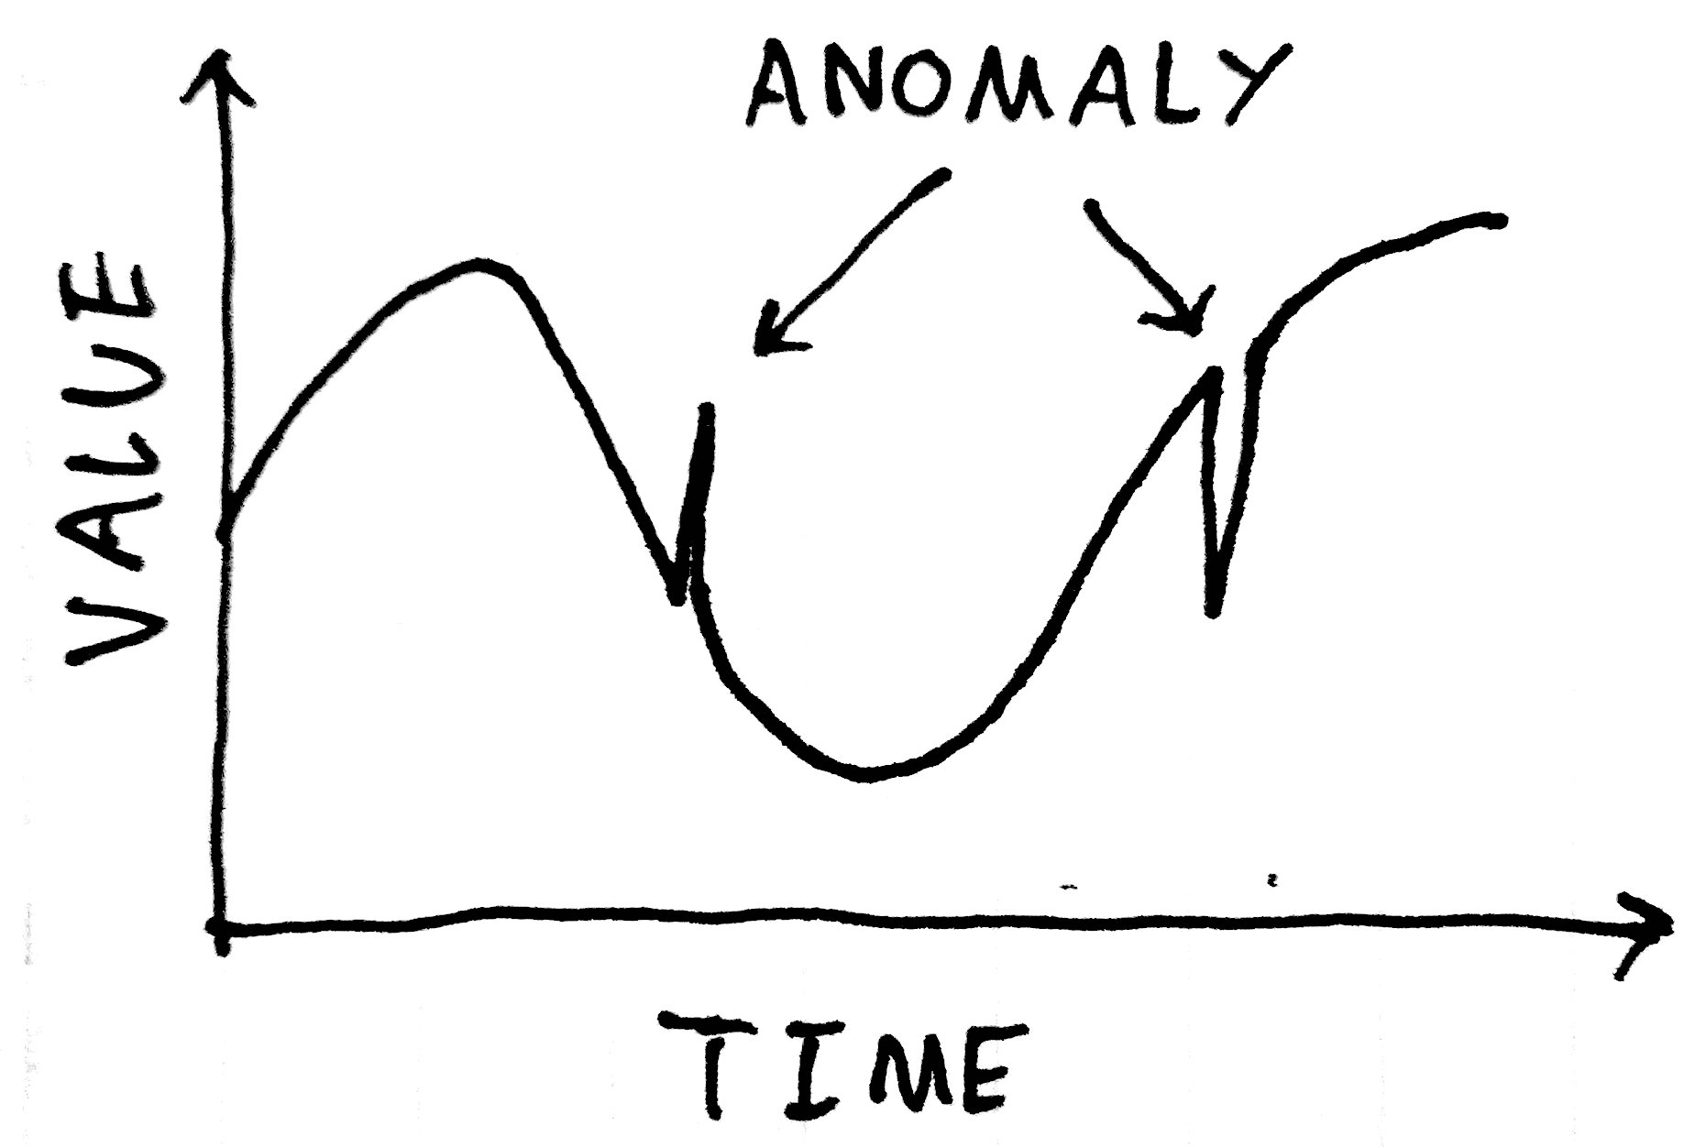
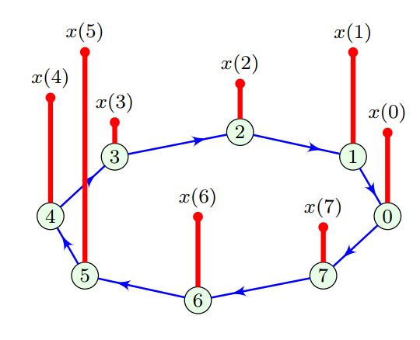
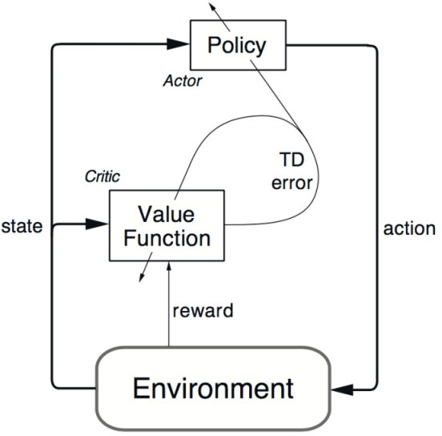
Objectives
Anomaly detection on signal
Detecting anomalies and changes on a signal (multiple related signals) using the generated graph signal.
Generate the sufficiently complex graph signal using a machine learning approach (reinforcement learning)
Graph Signal
Reinforcement
Learning

Slide 5

Justification

Slide 6
Justification (Why using graphs)
Graphs are a powerful abstract structure to store data and can be used to represent different measured values regardless of the nature of the data.
Many approaches neatly generalize when thought of in graph terms.
A signal can be considered as a time-series. Using graph machine learning we can create functions to spot recurring patterns .
Graph Signal

Slide 7
Justification (Why using RL)
Machine learning (ML) enables new forms of analysis and automation.
Multidisciplinary approaches can be quite complicated why not using automated ML algorithms like reinforcement learning (RL).
The unique nature of RL which evaluate the current solution (Value-function and Q-function) in each iteration can help us to achieve our goal (generating graphs which help us in detecting anomalies.)
Reinforcement
Learning

Slide 8
Introduction

Slide 9
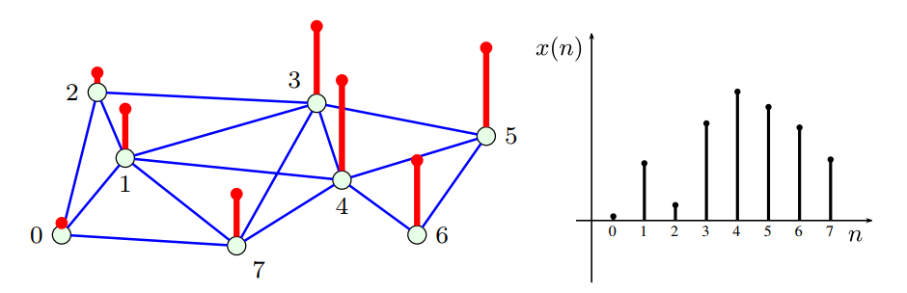
Introduction (problem statement)
Anomaly detection which is defined as the identification of suspicious data patterns, is a challenging task in practical signal processing applications due to the complexity and diversity of the anomalies.
A recent approach to analyze the signal is to use the graph signals that can describe its normal behaviors and patterns of the data due to its powerful abstract structure representation.
Anomaly detection on signal
Graph Signal

Slide 10
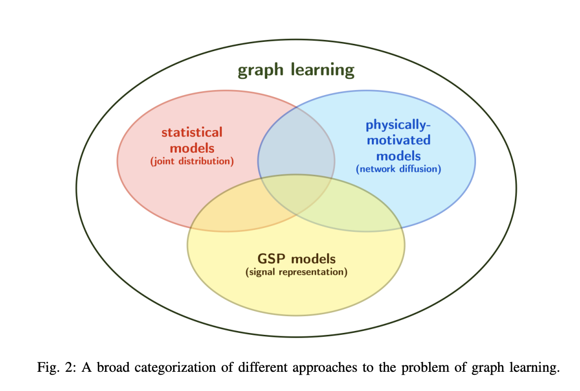
Introduction (problem statement)
Using traditional algorithmic techniques such as statistical models (probabilistic graphical models) and physically-motivated models (network diffusion or cascades) to generate the corresponding graph topology out of the simple (multiple related) signal is making the problem too complex to solve why not using the automated machine learning approaches.
ML approaches try to build the graph signal with needed complexity not too complex (overfitting) and not too simple (underfitting).
At this master thesis, I am try to build overly general intelligent anomaly detection system using Reinforcement Learning and its ability to generate the graph signal of the time-series data (signal) to find anomalies and changes.
Graph Signal
Reinforcement
Learning

Slide 11
Background (Review of literature)

Slide 12
Background (Anomaly detection)
Anomalies can be categorized as:
Point anomalies: A single instance of data is anomalous if it's too far off from the rest. Business use case: Detecting credit card fraud based on "amount spent."
Contextual anomalies: The abnormality is context specific. This type of anomaly is common in time-series data. Business use case: Spending $100 on food every day during the holiday season is normal, but may be odd otherwise.
Collective anomalies: A set of data instances collectively helps in detecting anomalies. Business use case: Someone is trying to copy data form a remote machine to a local host unexpectedly, an anomaly that would be flagged as a potential cyber attack.
Note: Anomaly detection is similar to noise removal and novelty detection

Slide 13
Background (Anomaly detection)
Anomaly Detection Techniques:
Simple Statistical Methods: flag the data points that deviate from common statistical properties of a distribution, including mean, median, mode, and quantiles (low pass filter (n-period simple moving average), Kalman filter).
Machine Learning-Based Approaches:
Density-Based Anomaly Detection
K-nearest neighbor
Local outlier factor (2014)
Clustering-Based Anomaly Detection: unsupervised
K-mean
Support Vector Machine-Based Anomaly Detection: supervised

Slide 14
Background (Anomaly detection - time series)
from a business perspective link
Anomaly detection problem for time-series data (signal) is usually formulated as finding of rare items, events or observations.
Some important types of anomalies are:
additive outliers: unexpected growth of users
temporal changes
trend changes
level shifts or seasonal level shifts
visualize a confidence interval

Slide 15
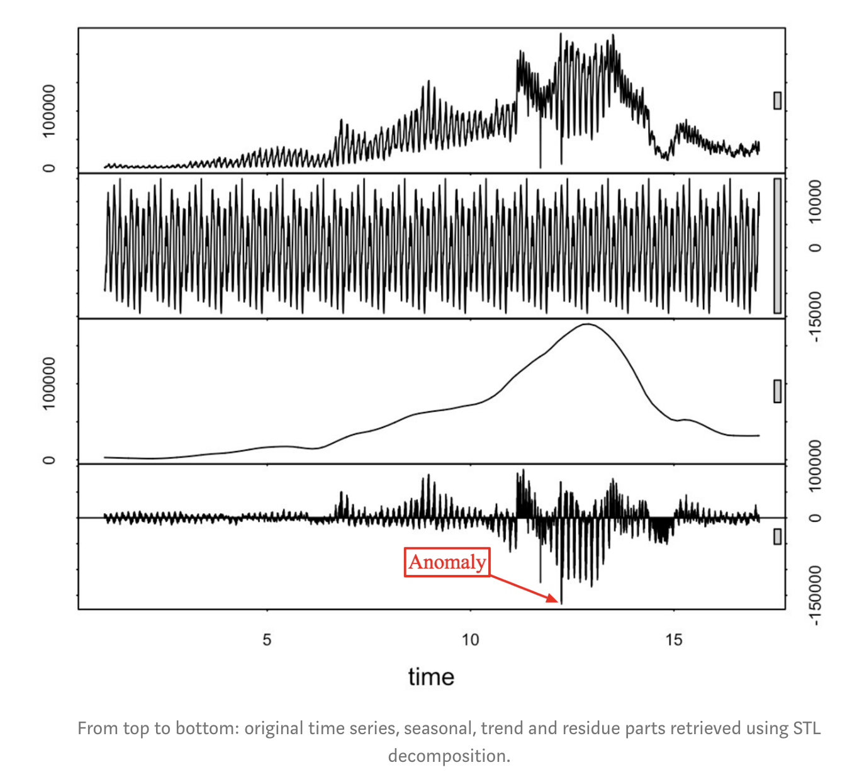
Background (Anomaly detection - time series)
STL decomposition: seasonal decomposition of time series by Loess): split your time series signal into three parts: seasonal, trend and residue.
use median absolute deviation for
Seasonal time series

Slide 16
Background (Anomaly detection - time series)
Classification and regression trees (ML approach)
Supervised learning: labeled data points
Unsupervised learning: teach CART to predict the next data point in your series and have some confidence interval or prediction error as in the case of the STL decomposition approach. check if your data point lies inside or outside the confidence interval using Generalized ESD test, or Grubbs’ test.

Slide 17
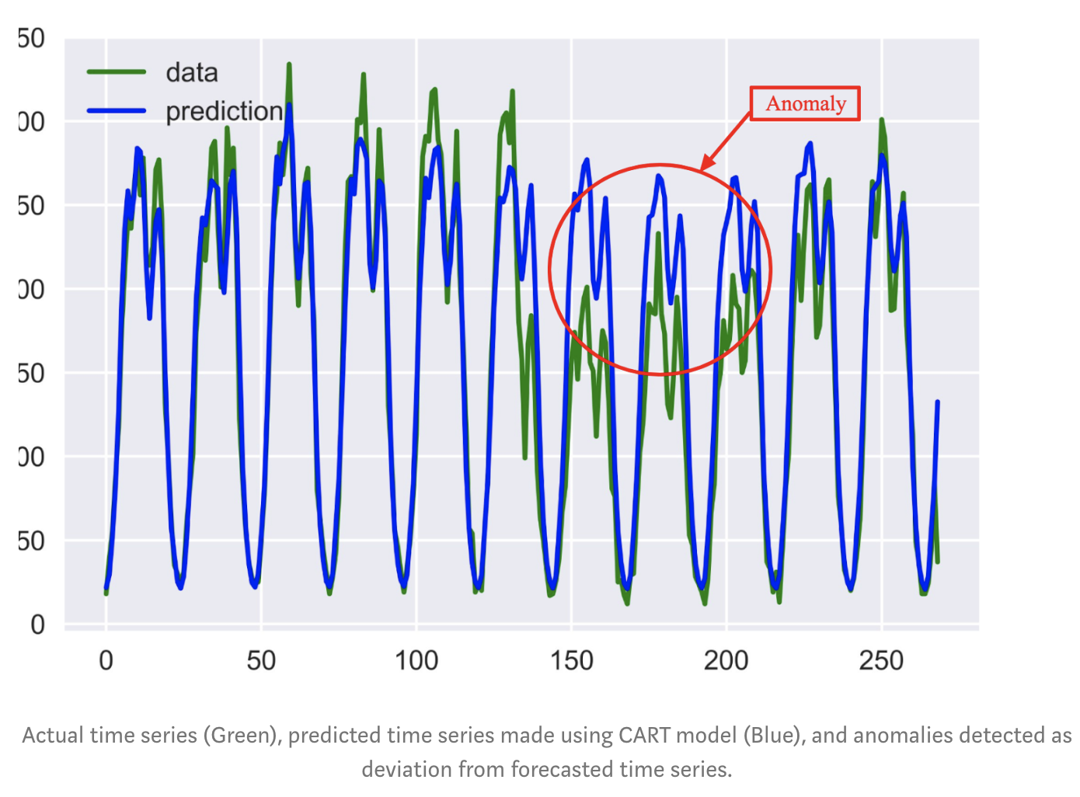
Background (Anomaly detection - time series)
Classification and regression trees (ML approach)
CART model

Slide 18
Background (Anomaly detection - time series)
ARIMA: autoregressive integrated moving average (Box–Jenkins method)
several points from the past generate a forecast of the next point with the addition of some random variable. the signal gets smoother.
Challenges:
select the number of differences
Select the number of autoregressions
Select the forecast error coefficients.
Not working for non-stationary signals
Each time you work with a new signal you should build a new ARIMA model.

Slide 19
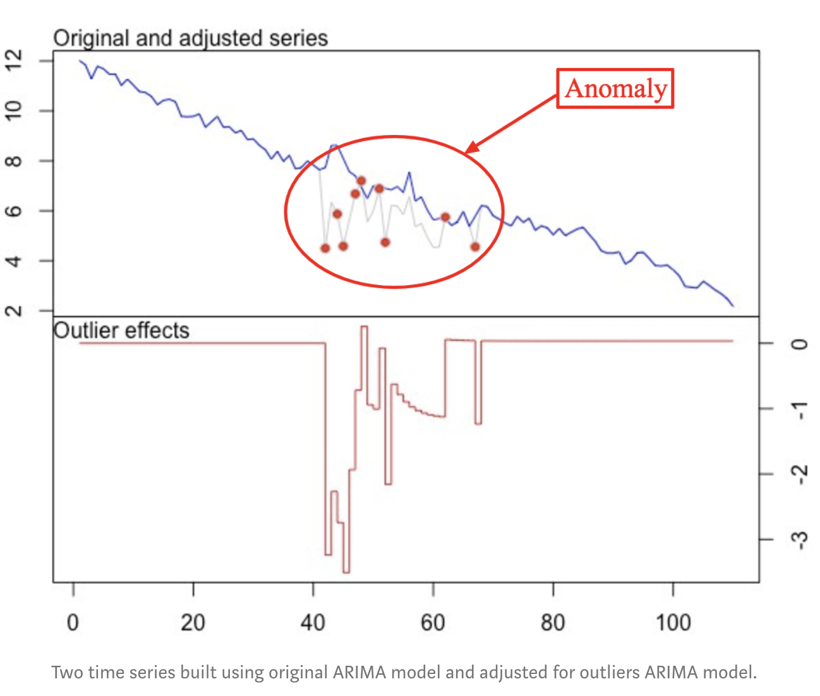
Background (Anomaly detection - time series)
ARIMA:
Anomaly detection is done by building an adjusted model of a signal by using outlier points and checking if it’s a better fit than the original model by utilizing t-statistics.

Slide 20
Background (Anomaly detection - time series)
How to capture seasonality:
Holt-Winters seasonal method: to define the seasonal period which can equal to a week, month, year, etc.

Slide 21
Background (Anomaly detection - time series)
Neural networks (LSTM): link
Long-Short-Term-Memory Networks for Anomaly Detection in Time Series (2015).
Can also be very helpful if you have multiple time series coupled with each other (link).

Slide 22
Background (Features of the signal)
There are two types of features:
Temporal features (time domain features): which are simple to extract and have easy physical interpretation, like: the energy of signal, zero crossing rate, maximum amplitude, minimum energy, etc.
Spectral features (frequency based features):which are obtained by converting the time based signal into the frequency domain using the Fourier Transform, like: fundamental frequency, frequency components, spectral centroid, spectral flux, spectral density, spectral roll-off, etc.

Slide 23
Background (Anomaly detection for simple, one dimensional scenario)
Three-sigma outlier detection rule (simple 1D univariate data = well suited however isn't applicable to multivariate data.)
IQR outlier test: inter-quartile range
Why they are not working?

Slide 24
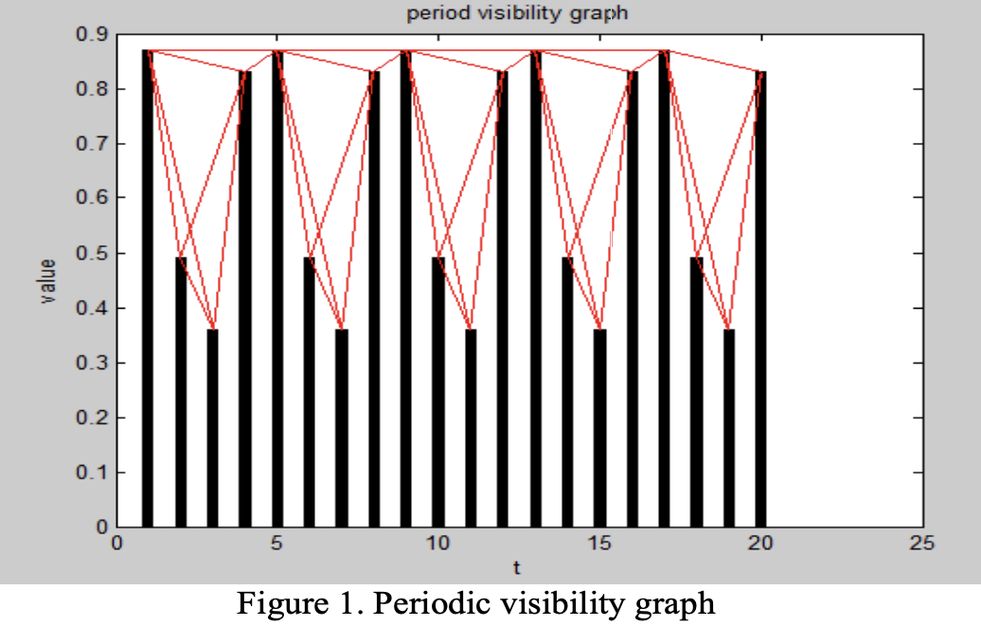
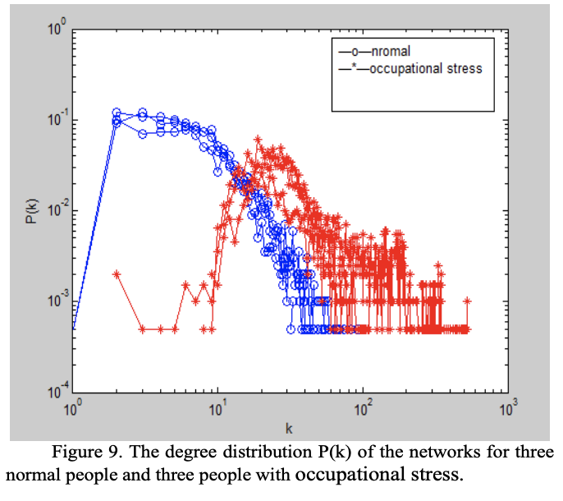
Background (Graph based signal processing)
Visibility graph: (Visibility Graph Analysis on EEG Signal)

Slide 25
Background (Graph based signal processing)
Visibility graph: Whereas a DFT decomposes a signal in a sum of (eventually infinite) modes, the visibility algorithm decomposes a signal in a concatenation of graph’s motifs, and the degree distribution simply makes a histogram of such ’geometric modes’.
time series = time domain
DFT = frequency domain
Visibility graph = visibility domain
Reversibility can be easily obtained weighting the links in the visibility graph with the slope of the visibility line.
A generic DFT fails to capture the presence of nonlinear correlations in time series (such as the presence of chaotic behavior).
The visibility algorithm can clearly distinguish between white noise (i.e. a sequence of identically independent random variables) and chaotic series.
Link

Slide 26
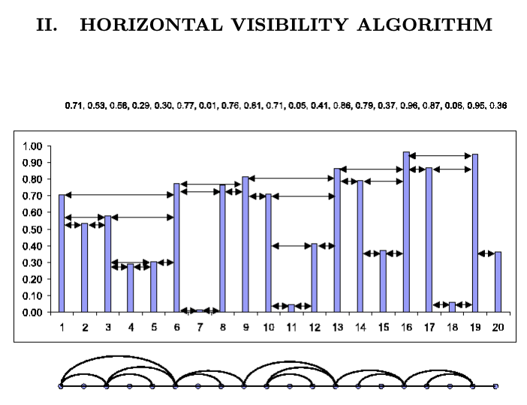
Background (Graph based signal processing)
Horizontal visibility graph: Horizontal visibility graphs: exact results for random time series

Slide 27
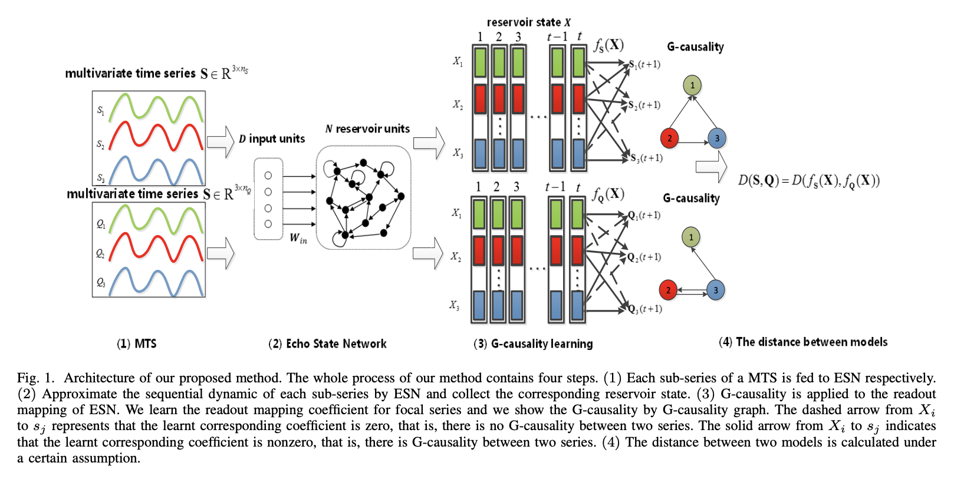
Background (Graph based signal processing)
Granger Causality for Multivariate Time Series:
Building the causal graph of the multivariable time series using GC.
Link

Slide 28
Background (Graph based signal processing)
To be studied: ?
Graph Embedding Techniques
Node2Vec

Slide 29
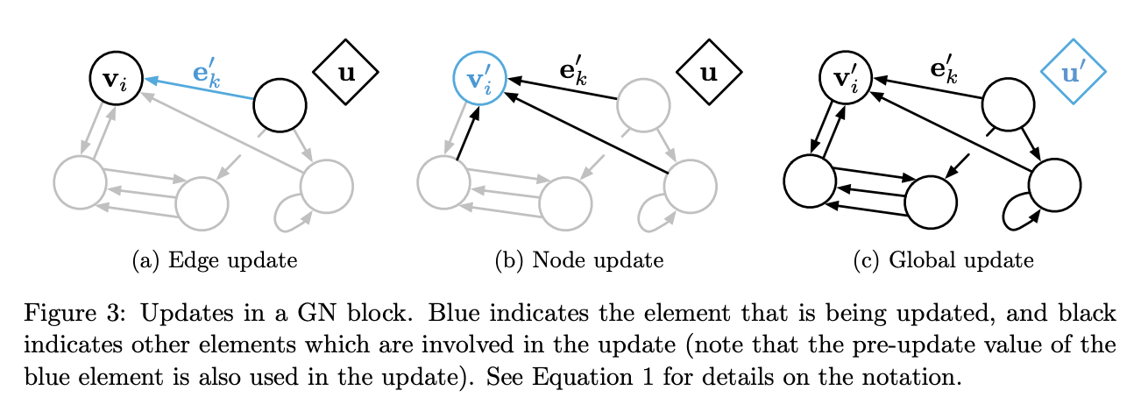
Background (Graph based signal processing)
Can I say the topology of the RNN is the graph that can represent the pattern in the data and learning the best RNN topology is somehow similar what I want to get?
Do you think this paper is useful and related? Relational inductive biases, deep learning, and graph networks
Update graph of each window signal

Slide 30
Background (Graph based signal processing)
Graph Learning:
link prediction: Predicting if a relationship exists between two nodes
Reinforcement learning: Multi-Hop Knowledge Graph Reasoning with Reward Shaping
Scoring and classification of nodes, edges and whole graphs
Attention sequences: Graph Classification using Structural Attention

Slide 31
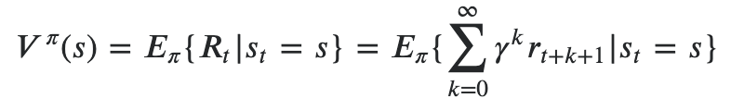
Background (Reinforcement Learning)
Using reinforcement learning to build a graph of a signal which maximize the correct anomaly detection.
Definitions:
(S)tate: each state is the generated graph for each window (interval) of the signal. So each state is the stream of graphs.
(A)ction: Can be two type ? Link prediction, Adding nodes
𝑃(𝑠,𝑠′,𝑎) = 1
𝑅(𝑠,𝑠′,𝑎): the immediate reward is the difference anomaly detection between previous state and current state. In the other words, our current stream of graphs is able to do anomaly detection better than before.
𝛾∈[0,1] = 1
Policy ???
Value-Function:

Slide 32
Solution

Slide 33
Solution
At this master thesis I want to solve the anomaly detection problem using the generated graph signal using reinforcement learning.

Slide 34
Implementation

Slide 35
Implementation
???

Slide 36
Validation

